Slide 1
Basics Electronics
(EC22001)

Slide 2
Contents
Semiconductor Theory
Review of PN junction operation
Plot and analyse V-I Characteristics of PN-Junction Diode

Slide 3
Semiconductors: Base of Electronics Industry
The construction of every electronic device begins with semiconductor material of highest quality.
The semiconductors fall somewhere midway between conductors and insulators.
The three semiconductors used most frequently in construction of electronic devices are Ge, Si and GaAs

Slide 4
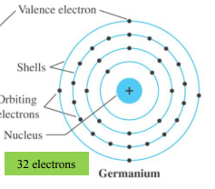
Germanium (atomic number 32: 2,8,18,4)
It has four valence electrons so known as tetravalent.
It was relatively easy to find and was available in fairly large quantities.
Easy to refine to obtain high levels of purity
Ge was first semiconductor to be used to construct Diode in 1939 and transistor in 1947
Drawback:
It has low level of reliability due to its sensitivity to changes in temperature

Slide 5
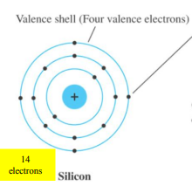
Silicon (atomic number 14: 2,8,4)
It has four valence electrons so known as tetravalent.
It is better than germanium due to its less temperature sensitivity and it is one of the most abundant material on earth.
So it becomes leading semiconductor material for electronic components and ICs
In 1954, First silicon transistor was introduced

Slide 6
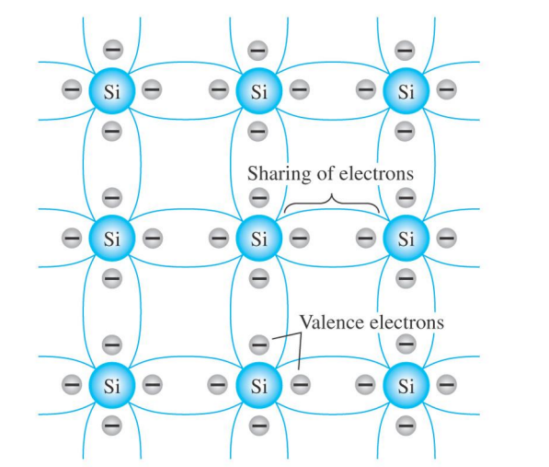
Covalent Bonding of pure silicon crystal

Slide 7
Growing demands of Industry
The field of electronics became increasingly sensitive to issues of speed.
Computers were operating at higher and higher speeds
Communication systems were operating at higher levels of performance.
So new semiconductor material was required

Slide 8
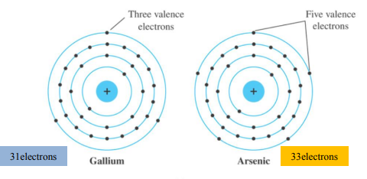
Gallium Arsenide
It is compound semiconductor which is constructed from two semiconductor materials Gallium (atomic number 31: 2,8,18,3) trivalent and Arsenic (atomic number 33:2,8,18,5) pentavalent
GaAs transistor was developed in early 1970’s whose speed of operation is fast upto five times that of silicon.
Drawback : difficult to manufacture and expensive

Slide 9
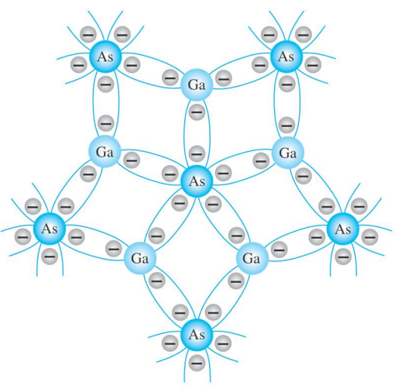
Covalent Bonding of GaAs

Slide 10
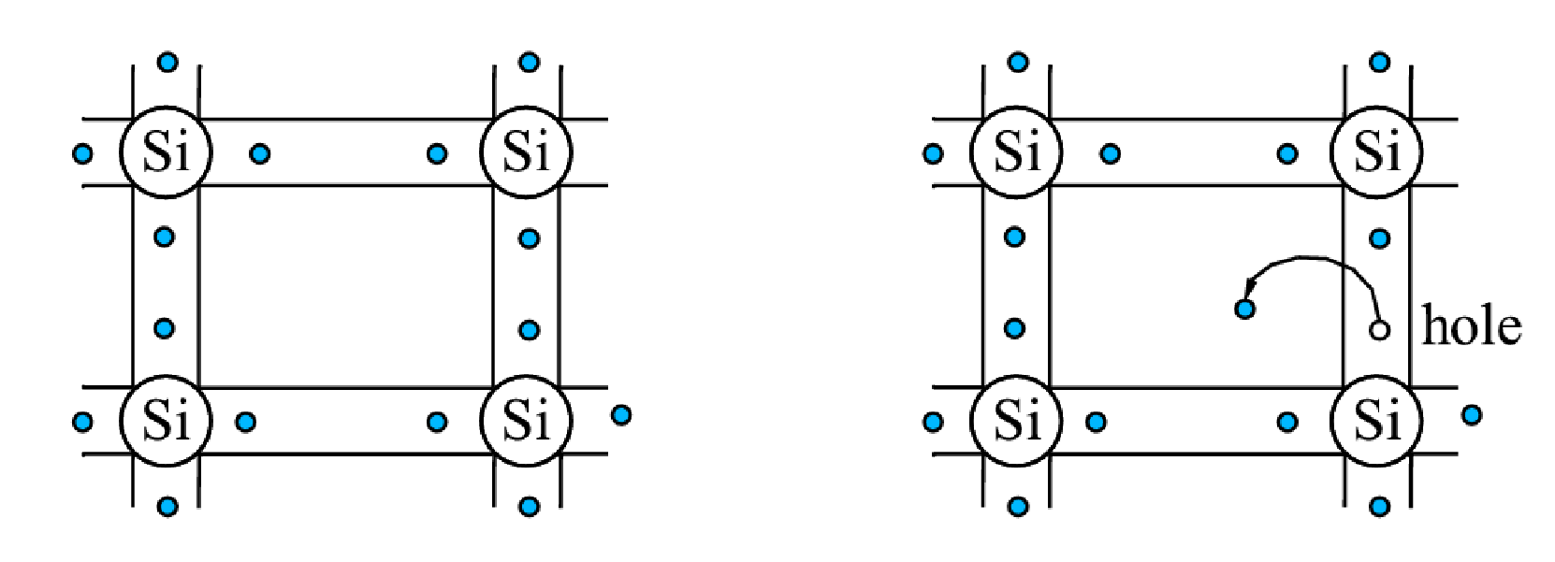
Si and Ge are tetravalent elements – each atom of Si (or Ge) has 4 valence electrons in its crystal matrix
Electrons and Holes
For T> 0 thermal fluctuations can break the electrons free, creating electron-hole pairs Both can move throughout the lattice and therefore conduct current.
T=0 all electrons are bound in covalent bonds no carriers available for conduction.

Slide 11
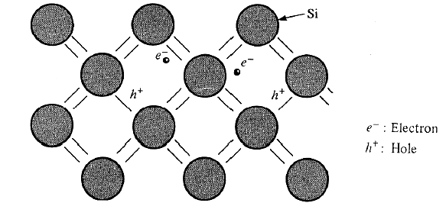
Intrinsic Material
A pure semiconductor crystal with no impurities or lattice defects is called an intrinsic semiconductor.
At T>0, Electron-hole pairs are generated.
EHPs are the only charge carriers in intrinsic material.
At T=0 K, No charge carriers.
Valence band is filled with electrons.
Conduction band is empty.
Since electron and holes are created in pairs – the electron concentration in conduction band, n (electron/cm³) is equal to the concentration of holes in the valence band, p (holes/cm³).
Each of these intrinsic carrier concentrations is denoted n_{i.}
Thus for intrinsic materials n=p=n_{i}
Electron-hole pairs in the covalent bonding model in the Si crystal.

Slide 12
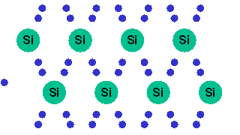
Intrinsic Silicon
At any temperature above absolute zero temperature, there is a finite probability that an electron in the lattice will be knocked loose from its position.

Slide 13
Intrinsic carriers and relative mobility
The free electrons in a material due to external causes are known as intrinsic carriers.
Number of intrinsic carriers in popular semiconductors are arranged in descending order as Ge>GaAs>Si
But electronic devices have fast response time due to maximum relative mobility of free carriers
Order of relative mobility is GaAs>Ge>Si

Slide 14
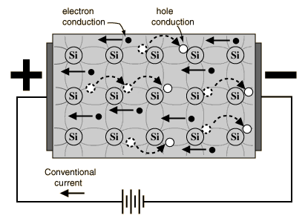
Current Flow through intrinsic semiconductor
If a voltage is applied, then both the electron and the hole can contribute to a small current flow.
NOTE: When flow of carriers is due to externally applied voltage, resultant current is called drift current. When current flow is as a result of gradient of carrier concentration, it is called diffusion current.

Slide 15
Increasing conductivity by temperature
As temperature increases, the number of free electrons and holes created increases exponentially.
Therefore the conductivity of a semiconductor is influenced by temperature, This is because the application of heat makes it possible for some electrons in the valence band to move to the conduction band. Semiconductors have negative temperature coefficient.

Slide 16
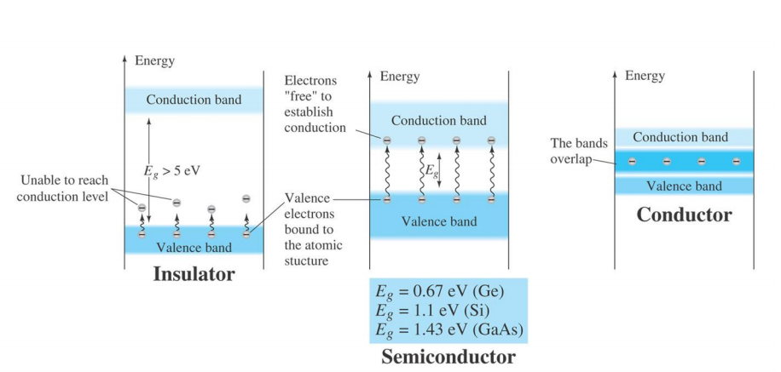
Energy Gap

Slide 17
Increasing conductivity by doping
Another way to increase the number of charge carriers is to add them in from an external source.
Doping or implant is the term given to a process whereby one element is injected with atoms of another element in order to change its properties.
Semiconductors (Si or Ge) are typically doped with elements such as Boron, Arsenic and Phosphorous to change and enhance their electrical properties.

Slide 18
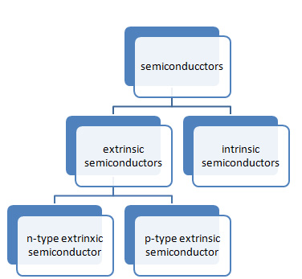
Types of Semiconductors

Slide 19
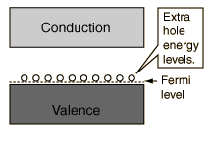
P-Type
The absence of an electron creates the effect of a positive charge, hence the name P-type.
Holes can conduct current. A hole happily accepts an electron from a neighbor, moving the hole over a space. P-type silicon is a good conductor.

Slide 20
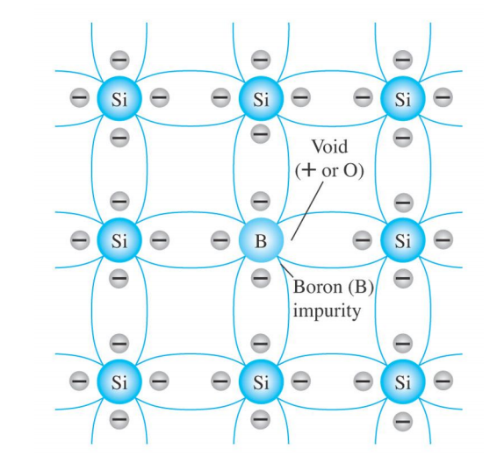
P type (trivalent impurity boron accepting electron from silicon)

Slide 21
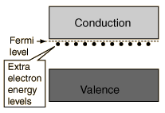
N-Type
It takes only a very small quantity of the impurity to create enough free electrons to allow an electric current to flow through the silicon. N-type silicon is a good conductor.
Electrons have a negative charge, hence the name N-type.

Slide 22
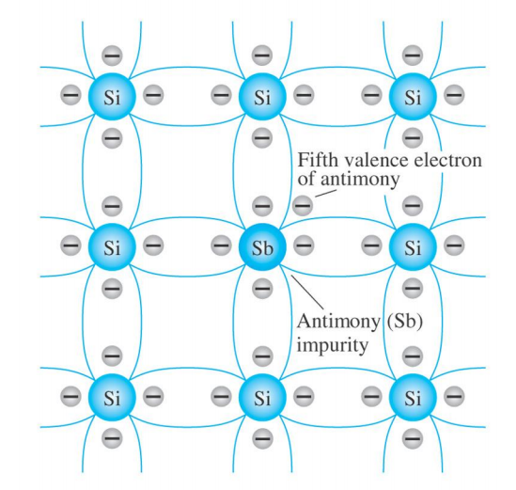
N type (pentavalent impurity Antimony donating electron to silicon)

Slide 23
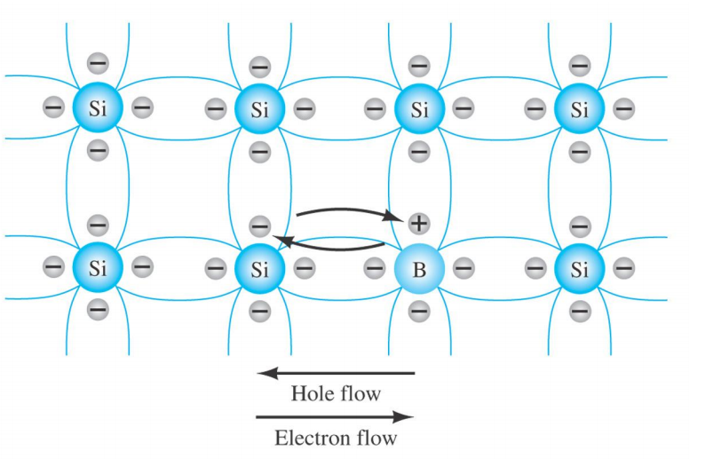
Electron versus hole flow
Valence electron (indicated by -) acquires sufficient kinetic energy to break covalent bond and fill void created by hole (indicated by +)

Slide 24
Types of Semiconductors

Slide 25
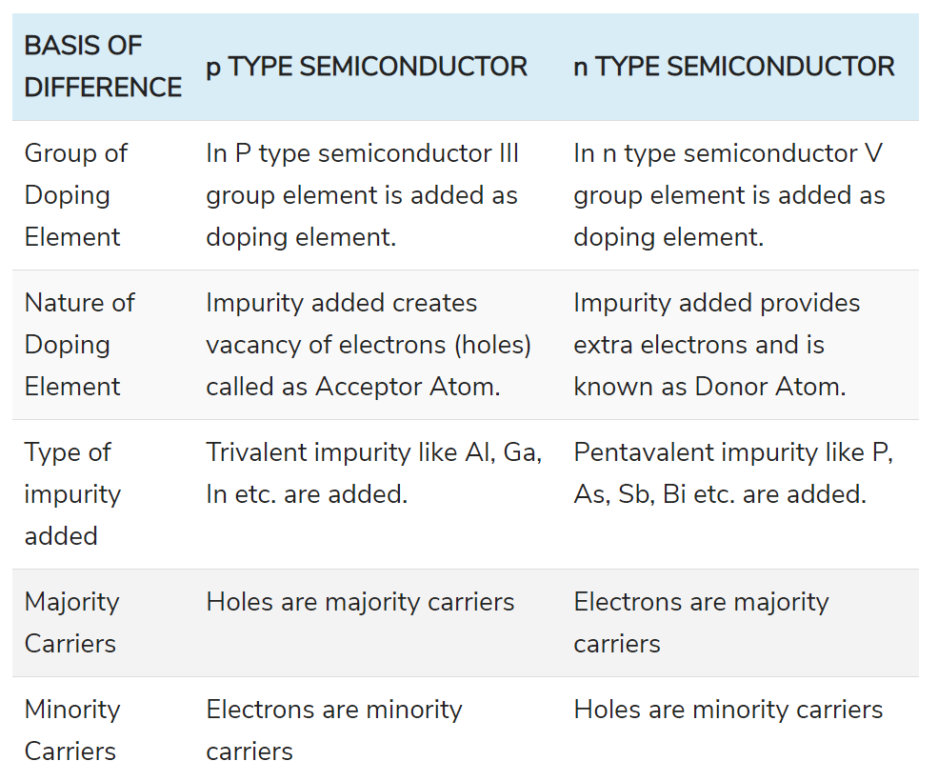
N type and P type

Slide 26
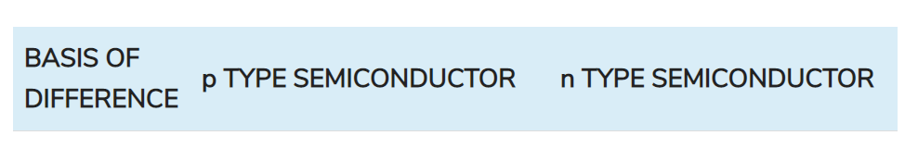
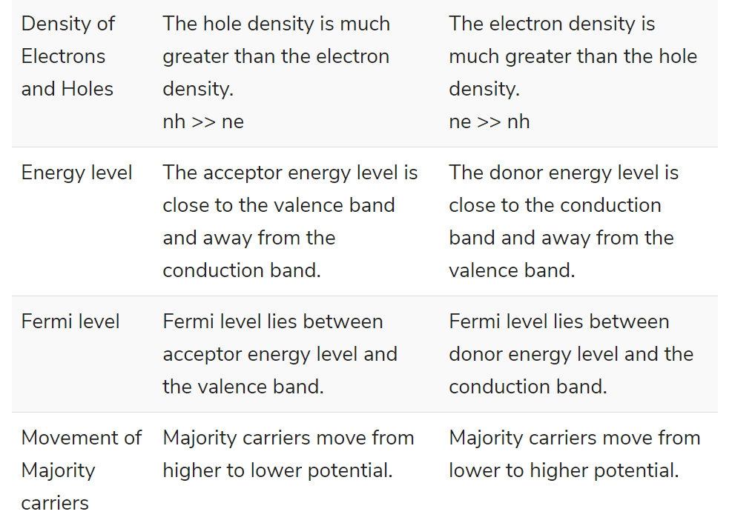
N type and P type

Slide 27
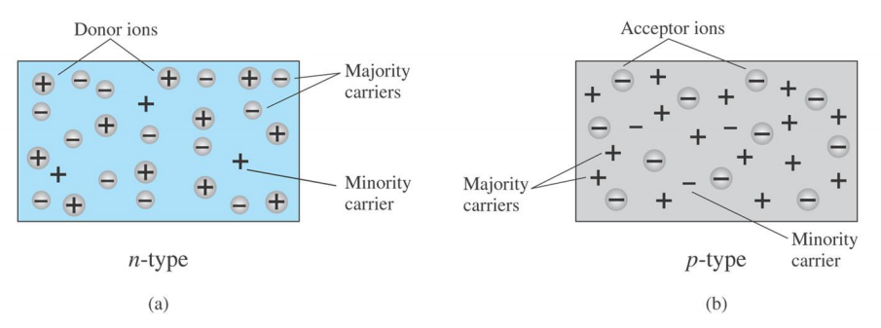
Majority and minority carriers

Slide 28
Formation of PN Junction
If the n type and p type materials are joined together.
In the n-type region there are extra electrons and in the p-type region, there are holes from the acceptor impurities.
the electrons from the n-region which have reached the conduction band are free to diffuse across the junction and combine with holes.
Filling a hole makes a negative ion and leaves behind a positive ion on the n-side. A space charge builds up, creating a depletion region.

Slide 29
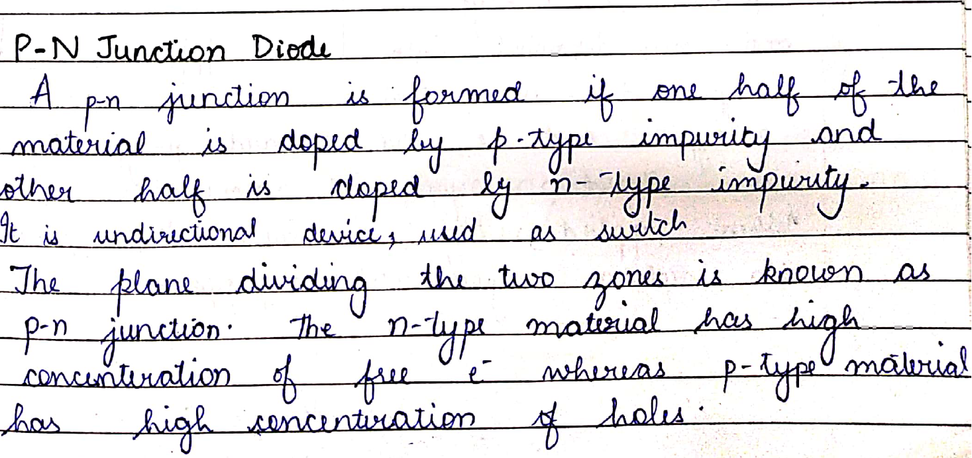
Formation of PN Junction

Slide 30
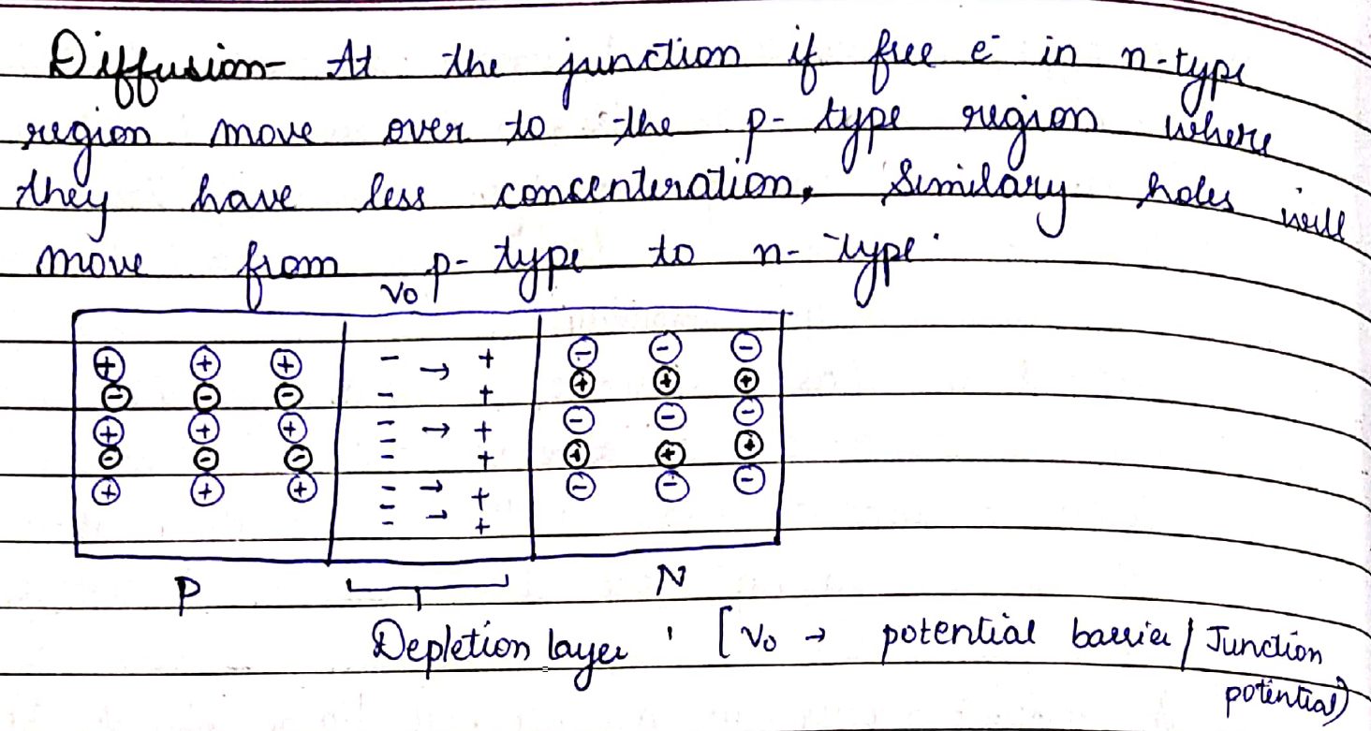
Diffusion

Slide 31
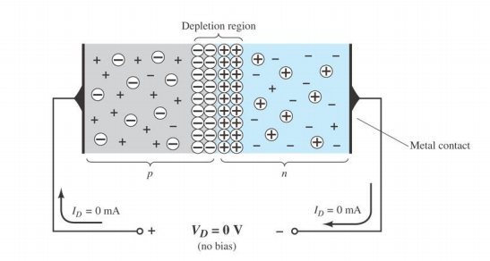
P-N Junction with no bias
When external voltage is zero, circuit is open and the potential barrier does not allow the current to flow. Therefore, the circuit current is zero.

Slide 32
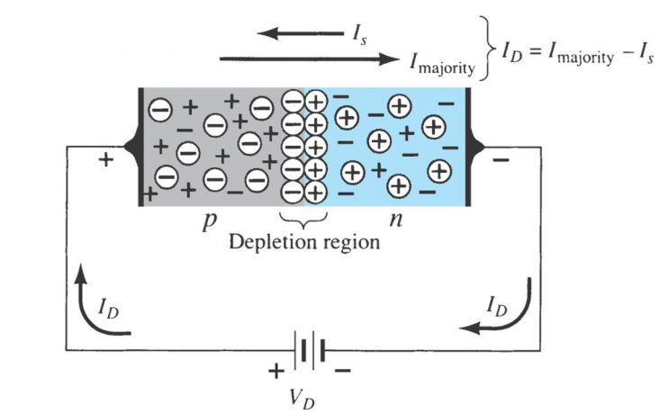
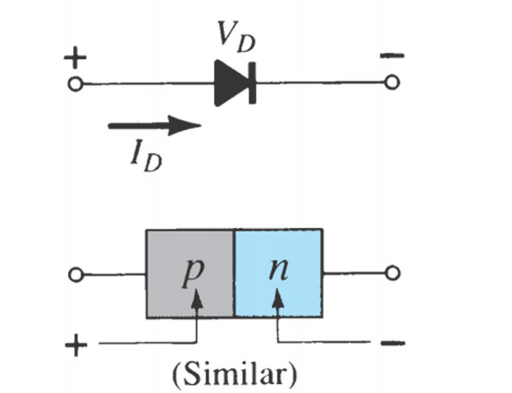
P-N Junction with Forward bias

Slide 33
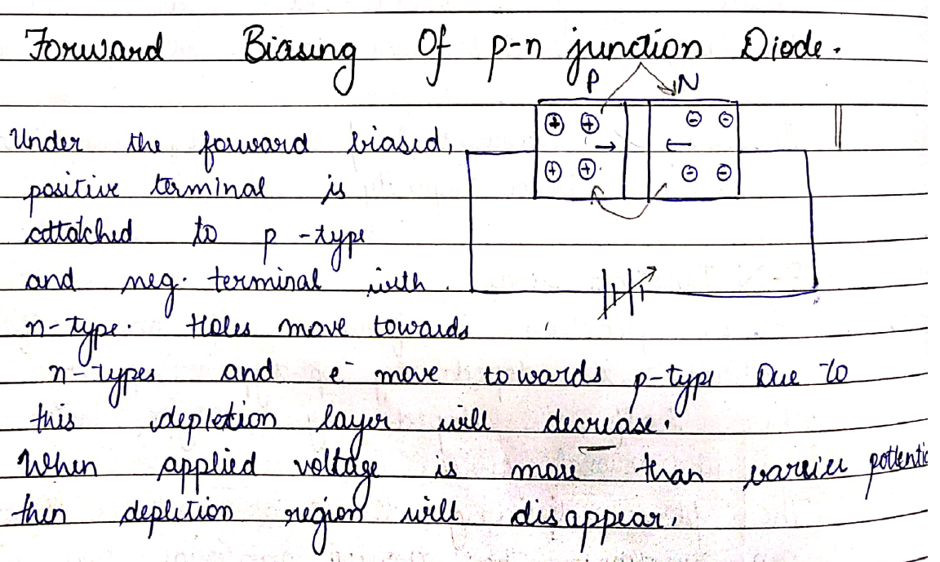
P-N Junction with Forward bias

Slide 34
P-N Junction with Forward bias
When P-type (Anode is connected to +ve terminal and n- type (cathode) is connected to –ve terminal of the supply voltage, is known as forward bias.
The potential barrier is reduced when diode is in the forward biased condition.
At some forward voltage, the potential barrier altogether eliminated and current starts flowing through the diode and also in the circuit. The diode is said to be in ON state.
The current increases with increasing forward voltage.

Slide 35
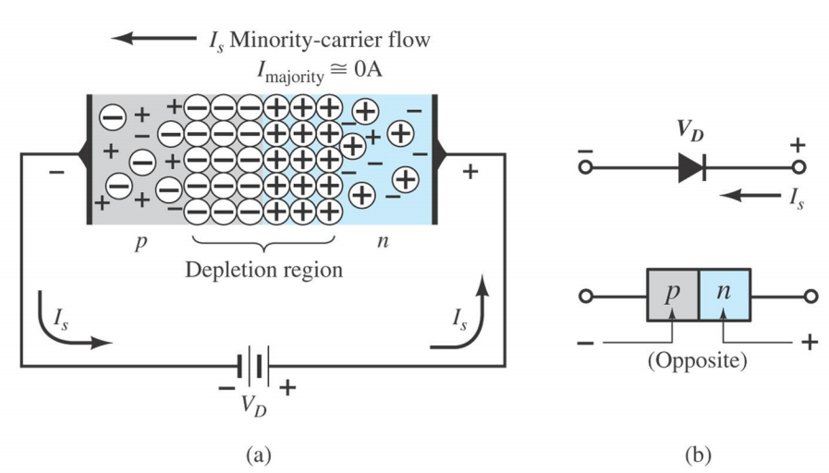
P-N Junction with Reverse bias

Slide 36
P-N Junction with Reverse bias
When N-type (cathode) is connected to +ve terminal and P-type (Anode) is connected to the –ve terminal of the supply voltage is known as reverse bias and the potential barrier across the junction increases.
Therefore, the junction resistance becomes very high and a very small current (reverse saturation current) flows in the circuit. The diode is said to be in OFF state.
The reverse bias current is due to minority charge carriers.

Slide 37
Important Definitions
Knee Voltage
The voltage is applied then the junction starts increasing rapidly. It is known as knee voltage and an alternate name of this is cut in voltage.
Breakdown Voltage
The minimum reverse voltage that makes the diode conduct appreciably in reverse.
Peak Inverse Voltage
The maximum voltage a diode or other device can withstand in the reverse-biased direction before breakdown.
Maximum Power Rating
Maximum power that a PN junction or diode can dissipate without damaging the device itself.
Maximum Forward Current
Breakdown Voltage
Breakdown Voltage

Slide 38
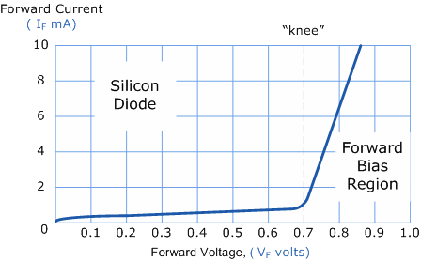
V-I Characteristics
1. Forward Bias Characteristics
Voltage increasing…>current increasing but in small amount
After barrier voltage (knee voltage) current increases rapidly.

Slide 39
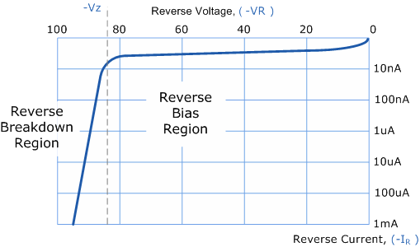
V-I Characteristics
Small amount of current is coming because of minority carriers.
On increase of voltage small amount of current is increasing.
If at beyond limit voltage is provided than depletion region breaks.
Electrons will get free then move therefore current will increase rapidly.
It will burnt out and will not work.
2. Reverse Bias Characteristics

Slide 40
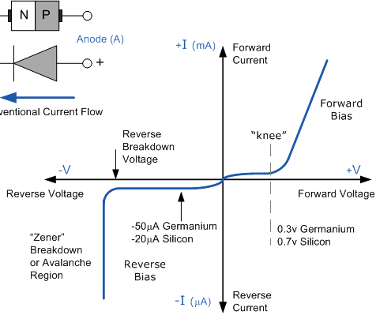
V-I Characteristics

Slide 41
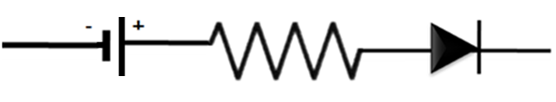
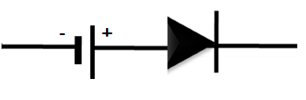
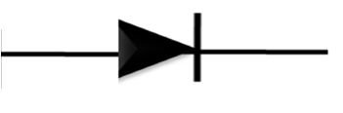
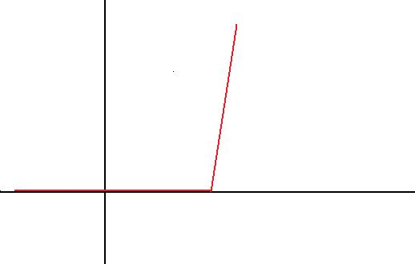
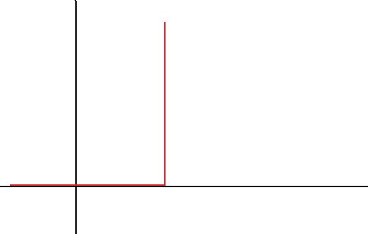
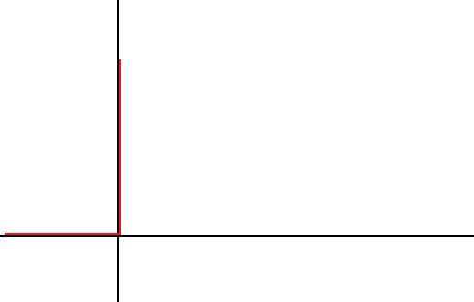
Equivalent Circuits
PIECEWISE-LINEAR
MODEL
SIMPLIFIED MODEL
IDEAL DIODE
TYPE
R_{network} » R_{av}
R_{network} » R_{av}
E_{network} » V_{T}
CONDITION
V_{T}
r_{av}
Ideal
Diode
V_{T}
Ideal
Diode
Ideal
Diode
MODEL
I_{d}
I_{d}
I_{d}
r_{av}
CHARACTERISTICS
o
V_{T}
V_{d}
o
V_{T}
V_{d}
o
V_{d}

Slide 42
Thank you

